Slide 1
pandoc
What is, when do you use?
- .theme – JSON
.sy – latex
.html - template

Slide 2
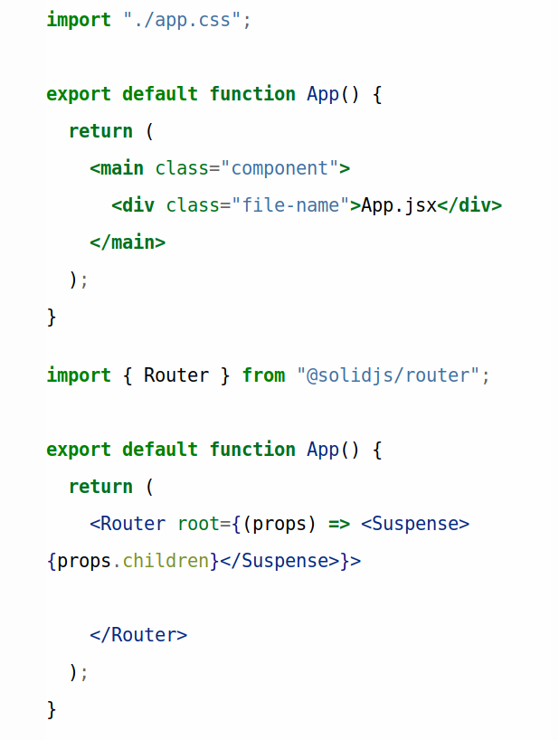

Slide 3
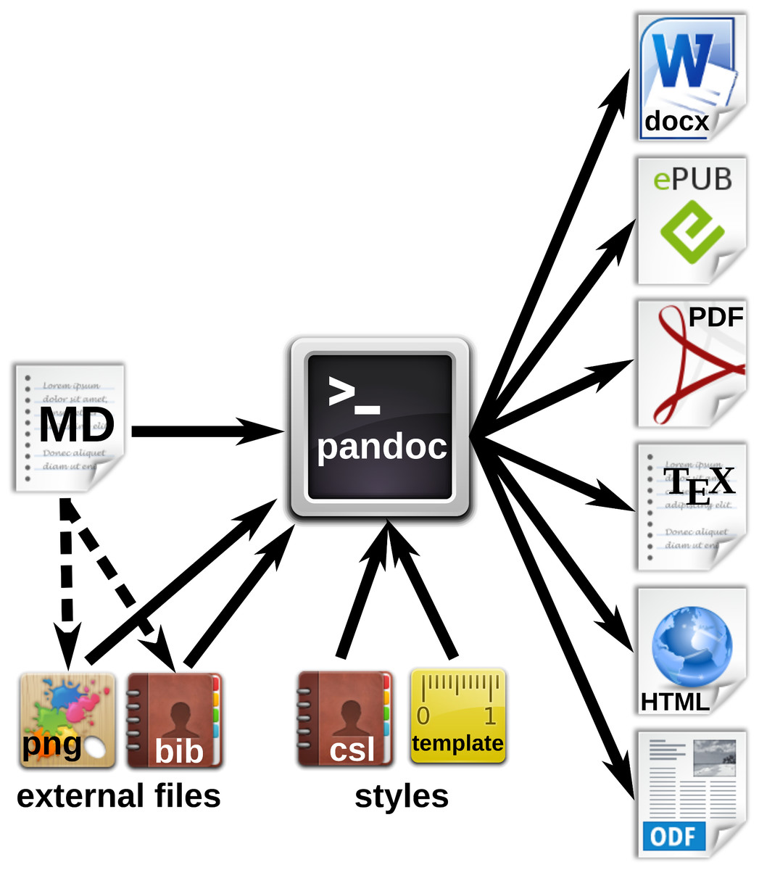

Slide 4
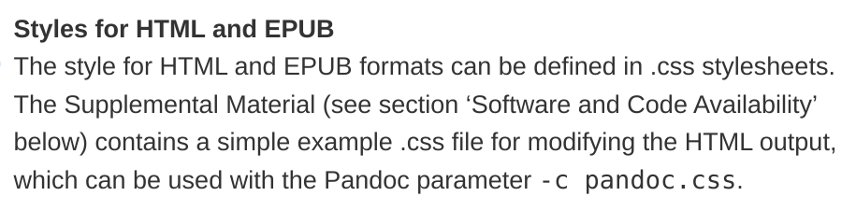

Slide 5
1. Make web with 2 fonts for comparison
2. Make the .theme

Slide 6
FA8D3E
FFAA33
F8F9FA
background

